Slide 1


Slide 2



CODE VERSE HACKATHON 2025
Problem Statement Title-SKU level ROAS tracking.
Team Name-Team Shunya.
Team Members-
Vedant Deshmukh Arnav Kale
Tejas Kurude Tanmay Akotkar

Slide 3
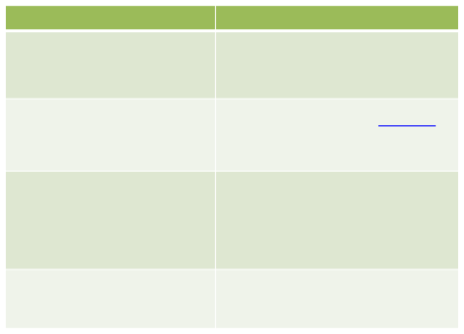
Current problem:
Our Approach:
Only aggregated ROAS tracking is done.
SKU-Level Attribution Engine
No SKU-level insight → risk of stockouts & overspending.
Inventory-Aware Ad Control
Margin Blindness: only topline of products is available.
Predictive Stockout Alerts
Dynamic Margin-Based Bidding
No real-time dynamic adjustment based on inventory levels, competitor pricing, or demand spikes.
“What-If” Simulation Dashboard

Slide 4

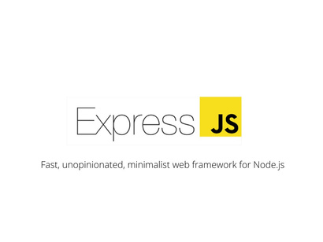

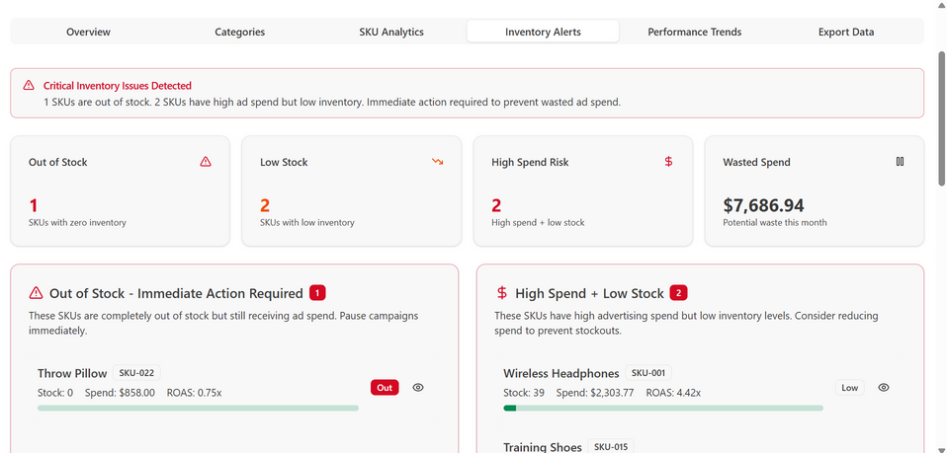


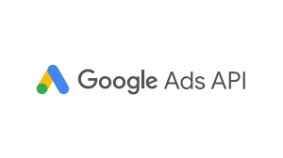
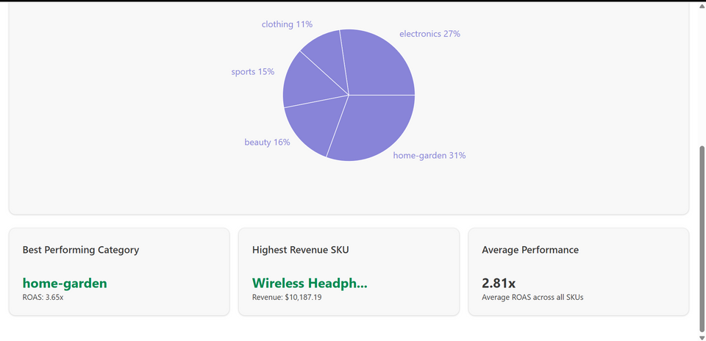
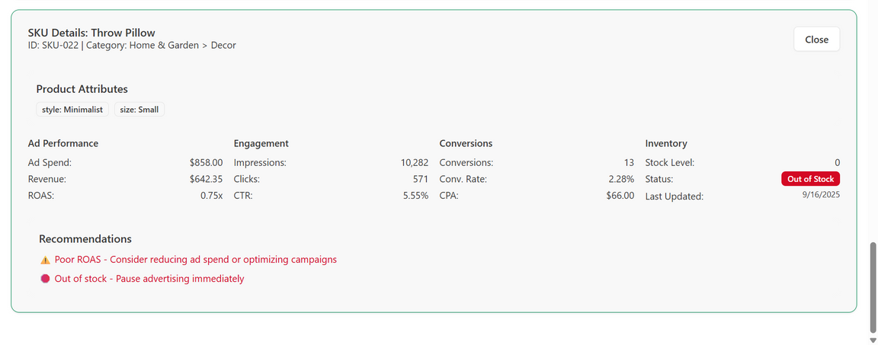
TECHNICAL APPROACH

Slide 5


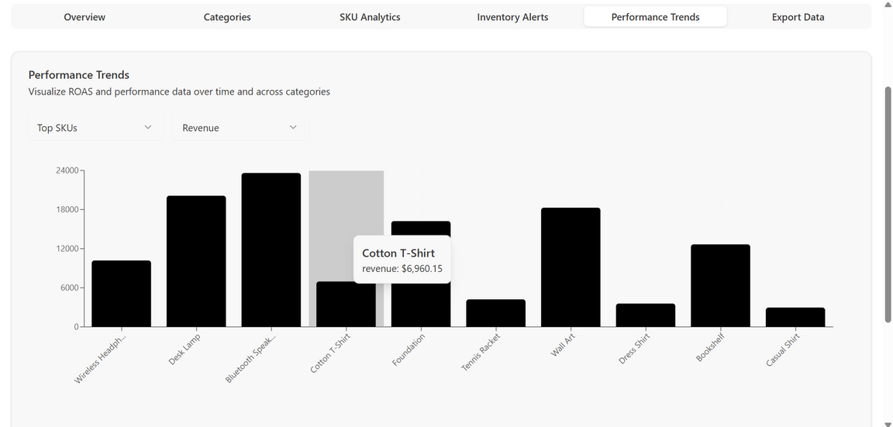
FEASIBILITY AND VIABILITY
Existing Technology in Use:
How Our System Fits In:
Data Integration Layer
Uses APIs from ad platforms + ERP systems → unifies data at SKU level.
Decision Layer
SKU Attribution Engine + Predictive Stockout Model → generates a ctionable insights.
Dashboard Layer
Provides SKU-wise ROAS, margin-adjusted ROI, and inventory-aware ad recommendations.
Human-in-the-Loop
Marketing managers get alerts & recommendations → they approve or override → system learns over time.
Ad Platforms: Google Ads, Meta Ads, Amazon Ads already provide campaign/ad-group level data.
ERP & Inventory Systems: SAP, Zoho, Tally, Oracle NetSuite widely used in retail/e-commerce for SKU & stock tracking.
Business Intelligence Tools: Power BI, Tableau used for reporting — but only aggregated, not SKU-aware.
Scalability & Viability
Policy Aligned:
Supports Digital India, Open Network for Digital Commerce (ONDC) by giving SMEs advanced analytics.
Operational ROI:
Reduced ad wastage → 10–20% ad budget savings.
Better inventory turnover → fewer stockouts + dead stock.
Business Impact:
Aligns marketing + inventory + finance in one loop.
Improves bottom-line profitability (margin-aware ROAS).
Scalability:
Works for small retailers (basic APIs + dashboards) to large e-commerce (cloud-scale pipelines).
Modular → can plug into any ERP + ad platform.

Slide 6

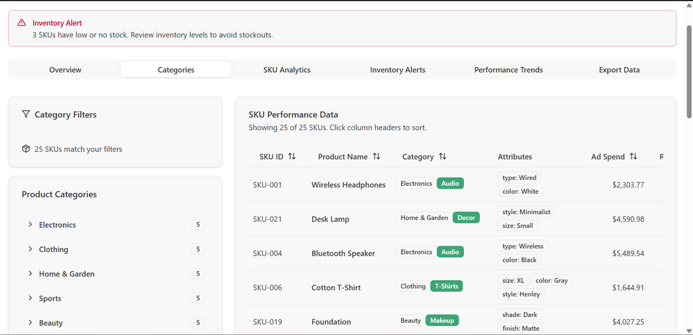
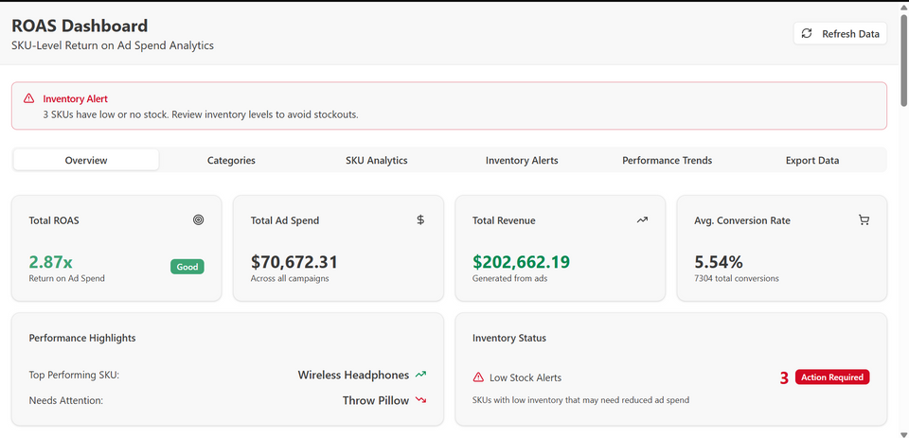
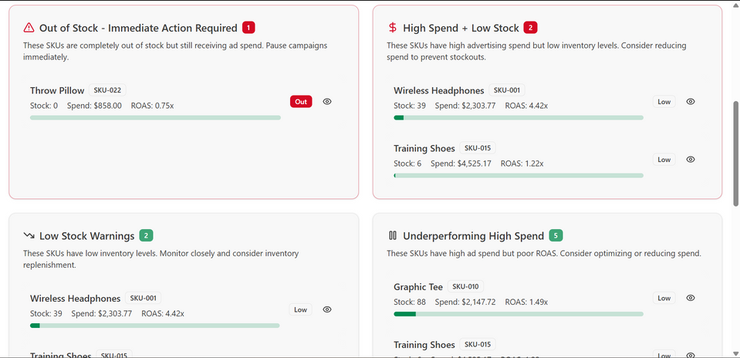
IMPACT AND BENEFITS
Operational Benefits
User Benefits
Eliminates Ad Wastage → Auto-pauses campaigns for out-of-stock SKUs, reallocates spend to profitable items.
Granular SKU-Level Visibility → Tracks ROAS and margins per product, not just campaign averages.
Predicts Stockouts & Overstocks → Forecasts SKU demand, aligning marketing spend with inventory health.
Real-Time Optimization → Dynamically adjusts bids & budgets based on sales velocity, stock levels, and margins.
Better Product Availability → Ads shown only for SKUs actually in stock → fewer “out-of-stock” disappointments.
Personalized & Relevant Ads → Customers see promotions for products that are useful and available, not random items.
Faster Fulfillment → Marketing aligned with inventory ensures stocked SKUs get sold → smoother delivery experience.
Improved Trust & Loyalty → No wasted clicks on unavailable products → builds long-term confidence in the platform.
Economic Benefits
Strategic & Social Impact
Reduced Ad Spend Wastage → Saves 10–20% of marketing budget by stopping ads on out-of-stock SKUs.
Higher Inventory Turnover → Faster movement of stock reduces holding costs.
Improved Profit Margins → Budget prioritization on high-margin SKUs increases bottom-line ROI.
Lower Operational Costs → Less manual coordination between marketing and inventory teams.
Supports Digital India & ONDC Vision → Empowers SMEs with enterprise-grade SKU analytics.
Promotes Sustainable Marketing → Cuts wasted ad spend on unavailable SKUs.
Boosts Retail Competitiveness → Equips Indian retailers with AI-driven decision support.
Strengthens Consumer Trust → Ensures ads always match in-stock products.

